Slide 1
Publishing in the Age of AI: what should opre do?
Amy R. Ward
Operations Research (OPRE) Editor-in-Chief
Outline:
Update on how the journal is thinking.
Discussion questions for you.

Slide 2
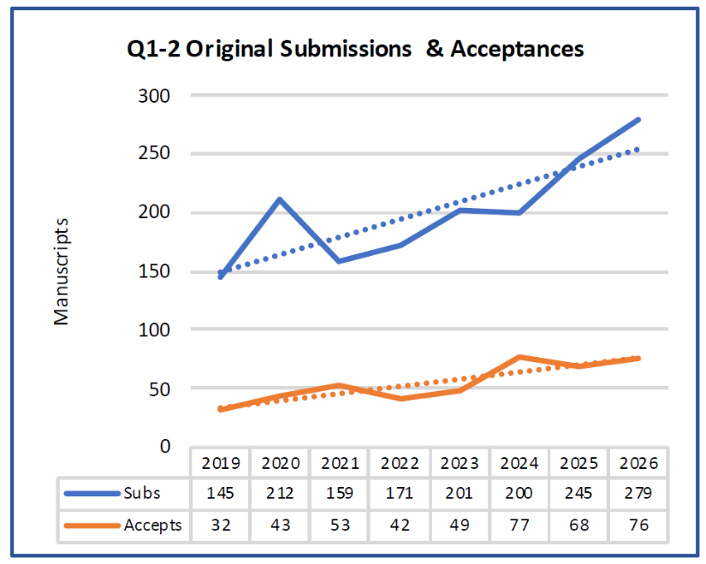
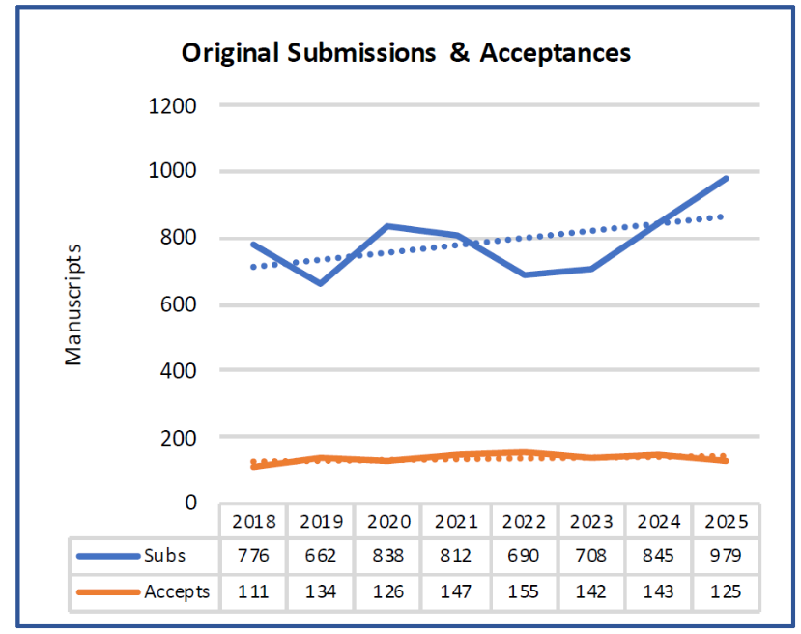
Submissions are increasing
39.5% increase from 2024 to 2026.
139.5%*845=1,178 submissions in 2026.
This is good to see people interested in the journal!
The worry is the reason for the increased submissions.
There is a story of one person writing 200 papers this past year!

Slide 3
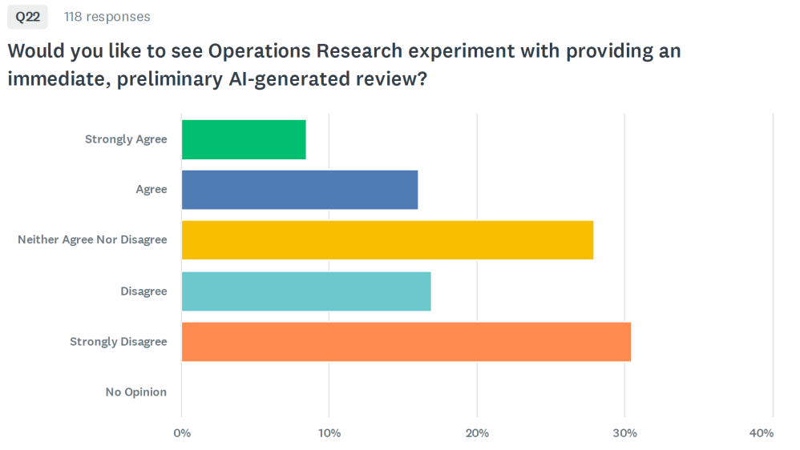
From opre stakeholder survey
50 responses (83 skipped).
Responses are all over the map, from enthusiastic to very concerned.

Slide 4
What is opre doing?
I did a first draft update to the journal’s AI guidelines, and shared with the AreaEds
and AEs for comment, but did not publish.
The (perhaps obvious) realization was: This is a big topic, larger than one person.
There is a committee convened with the following charge:
(1) To gather information on how authors and reviewers are using AI,
(2) To survey what other journals are doing;
(3) To make recommendations for what OPRE should be doing.
Committee members are the OPRE AreaEds: David Brown, Rene Caldentey,
Dan Iancu, Rouba Ibrahim, Raman Randhawa (chair), Cong Shi.
(Email them with your thoughts!)
Notes:
The purpose is to let people know that OR is thinking about what AI means for the journal. If the audience leaves feeling like OPRE is asking the right questions, and following a good process for what to do, then that is a win.

Slide 5
Some Principles
The OPRE AI Subcommittee unanimously agrees on the following:
Human judgement must be central to producing and evaluating research.
Journal quality metrics should not be lowered.
Human accountability and responsibility are critical for authors and reviewers.
AI usage should not be policed. (It is futile to police, and, debatable whether one
should do even if it were possible.)
Notes:
The purpose is to let people know that OR is thinking about what AI means for the journal. If the audience leaves feeling like OPRE is asking the right questions, and following a good process for what to do, then that is a win.

Slide 6
Questions for the community
What are the core principles of research ethics in OR/MS publishing, and does
AI fundamentally change any of them*?
How will AI affect the future of journals? And what will it mean for top journals
to play the role they have historically played in OM/OR**?
How should leading OR/MS journals redefine expectations for publishable
scholarship in the age of AI*?
What are your biggest hopes and fears for how AI is currently being used by
authors and reviewers?
FYI. There is the following Panel at INFORMS, organized by Esra Buyuktahtakin Toy.
OR/MS Research and Publishing in the Age of AI: Ethics, Integrity, and Human Judgement.
When: Monday, Nov 2, 11am-12:15pm
Where: Moscone South-303 (Level 3)
Panelists: Chris Tang, Chris Loch, Amy Ward
Moderator: Esra Buyuktahtakin Toy
* Credit Esra
** Credit Omar
Notes:
My thoughts on the answers to the Qs:
Core principle = You own your work, whether that is as an author or a referee. Something that AI fundamentally changes – and let me credit Gal Mendelson for articulating this to me – is that no one owns what comes out of Claude/ChatGPT/etc in the same way that is true of a research paper (or news article or internet page or book). If you use someone else’s research, you know who was responsible for its correctness. You do not know that with Claude/ChatGPT/etc. This places more burden on you to know enough to be able to evaluate what is coming back at you.
One significant role that top journals play is filtering what is out there. I cannot read every paper on arXiv or SSRN, so I outsource some of the responsibility for that filtering to the journals. That seems to me potentially even more important if we are going to an age where there is a lot more *stuff* generated. As a human, the rate at which I can genuinely absorb and understand something is bounded.
The bar for publishing is re-assessed. Reviewers have been taking length as a proxy for quality, thinking that length shows thoroughness and completeness. I’m not sure that is the case anymore. The focus is going to be even more on the density – i.e., the idea quality relative to the length. I think we may want to return to the days of shorter papers.
Biggest hope = AI will help us identify errors that previously went unnoticed, and find relevant literature we may have otherwise missed, and stimulate our thinking in unexpected ways. Biggest fear = This will sometimes be hard to resist the temptation to use AI-generated things that we don’t fully understand (like AI-generated code or proofs). A world in which authors use AI to write more papers and reviewers use AI to help more with the reviewing and we forget about reading and thinking about each others’s ideas is NOT what academic community means to me.

